Slide 2

Project MentorHub Communication Subsystem
Bao Ly | 11.06.2024

Slide 3

Agenda
Overview
Use Case Diagram
UI Designs – Database Entity
Q&A

Slide 4
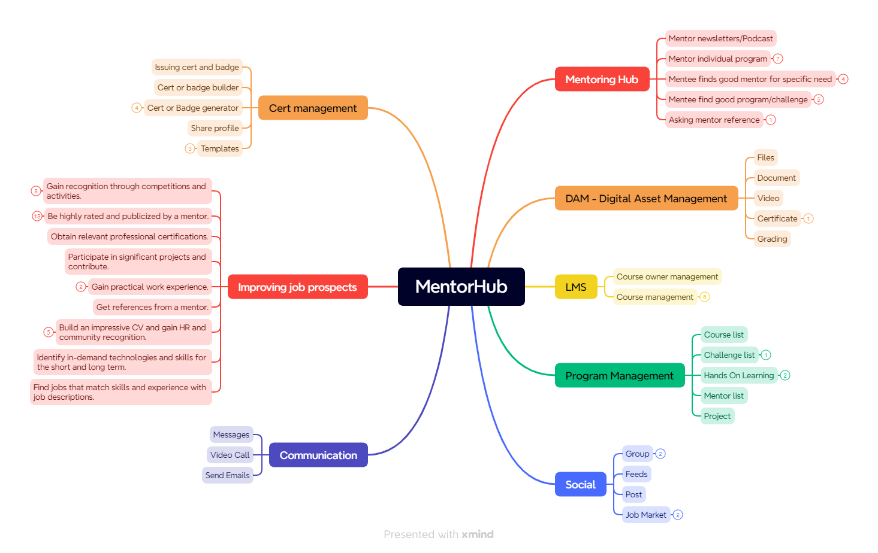
Overview – Mentor Hub

Slide 5
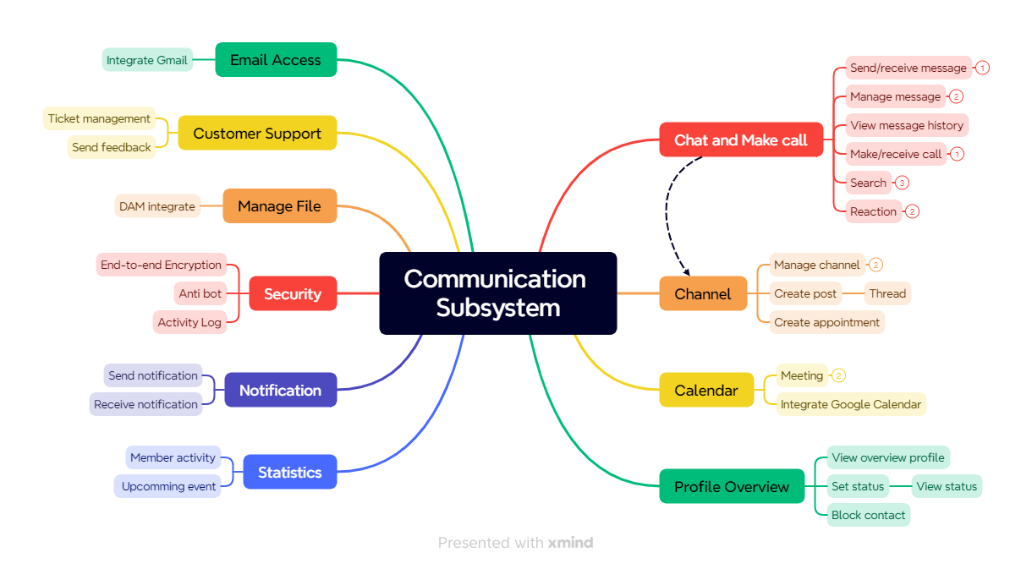
Overview – Communication Subsystem

Slide 6
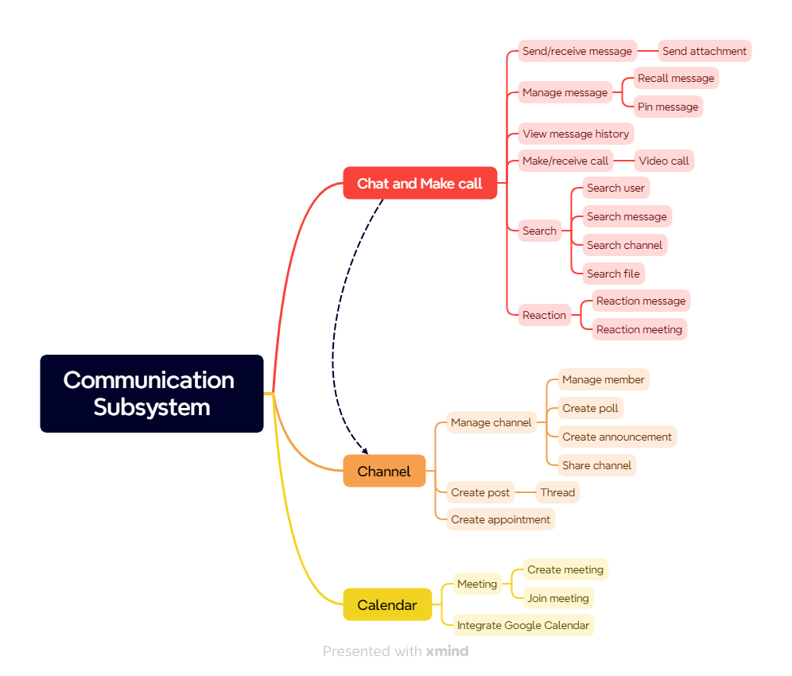
Overview – Communication Subsystem

Slide 7
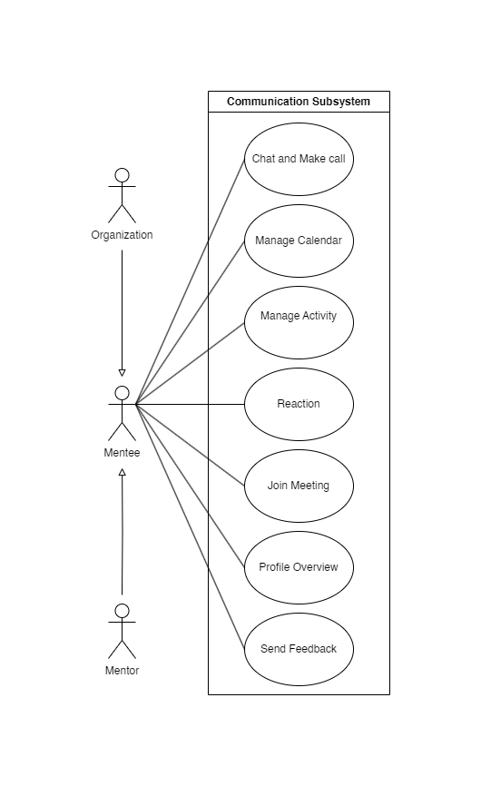
Use Case Diagram
4 actors:
Mentor
Mentee
Organization
System

Slide 8
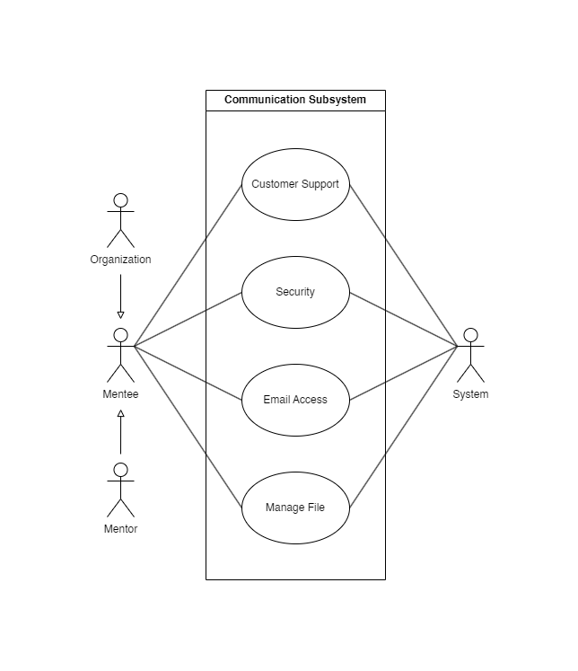
Use Case Diagram

Slide 9
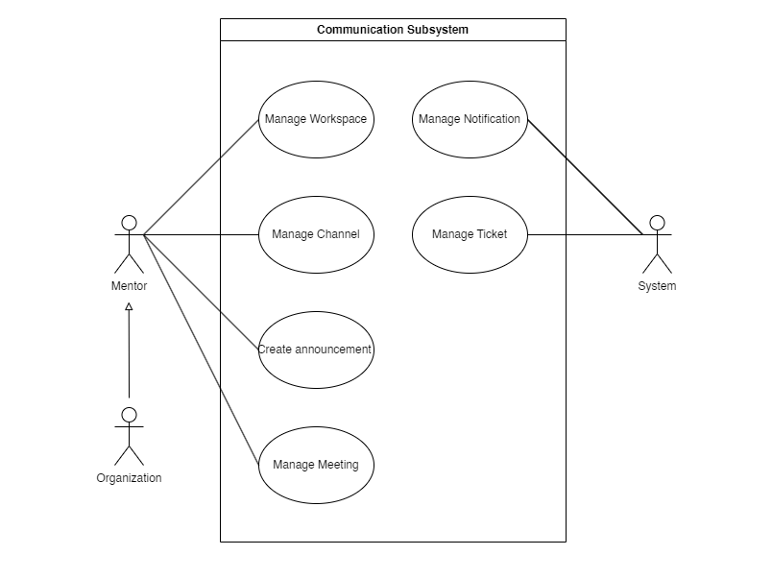
Use Case Diagram

Slide 10
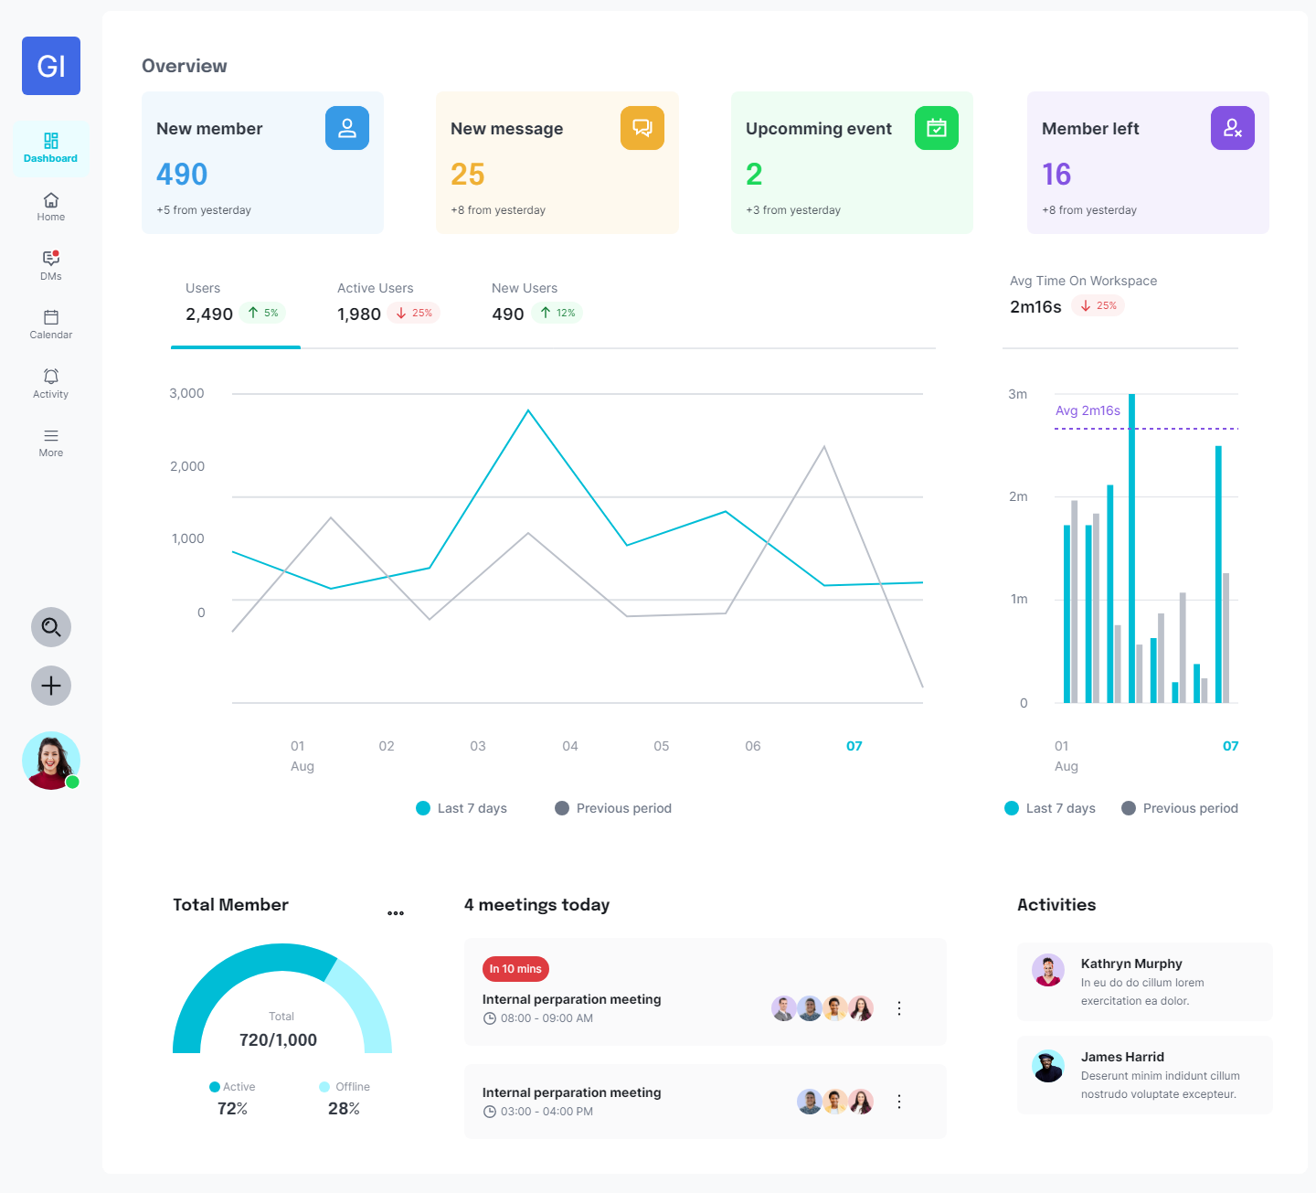
UI Design – Dashboard

Slide 11
UI Design – Dashboard

Slide 12
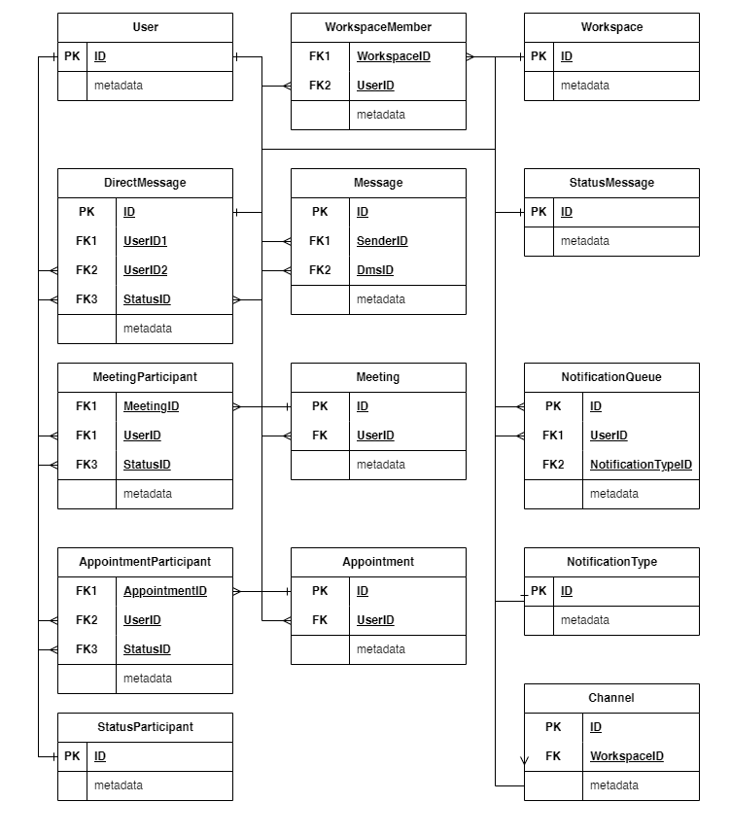
Database Entity – Dashboard

Slide 13
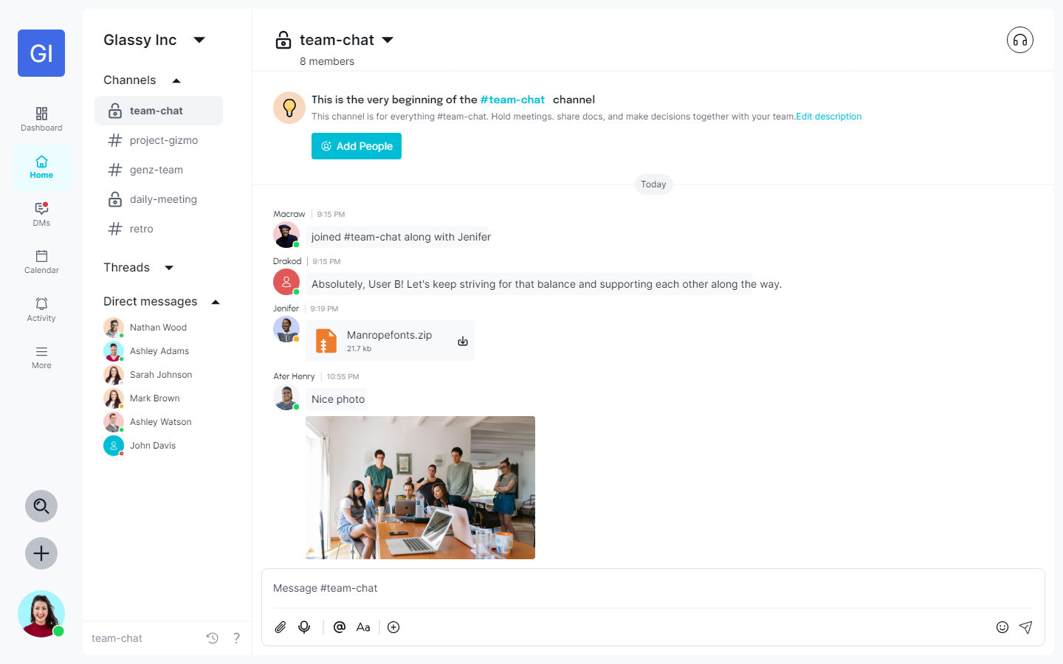
UI Design – Home

Slide 14
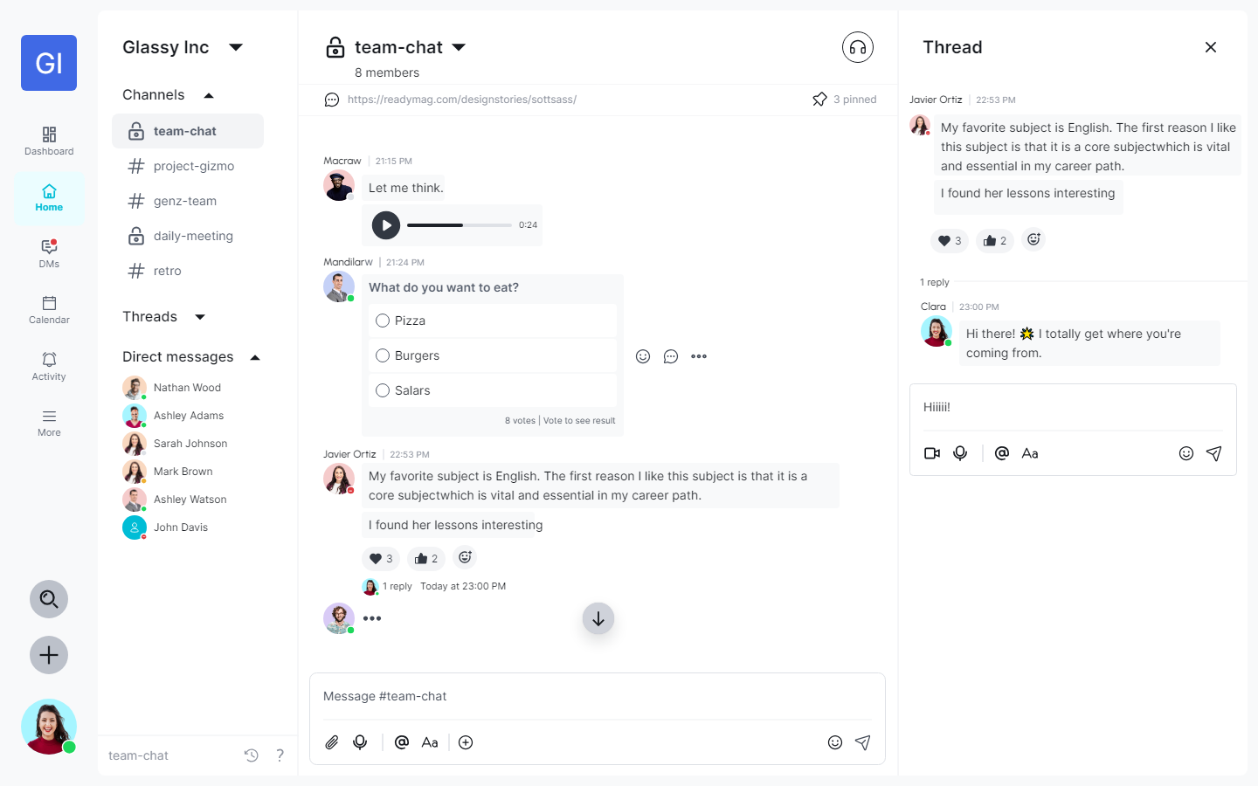
UI Design – Home

Slide 15
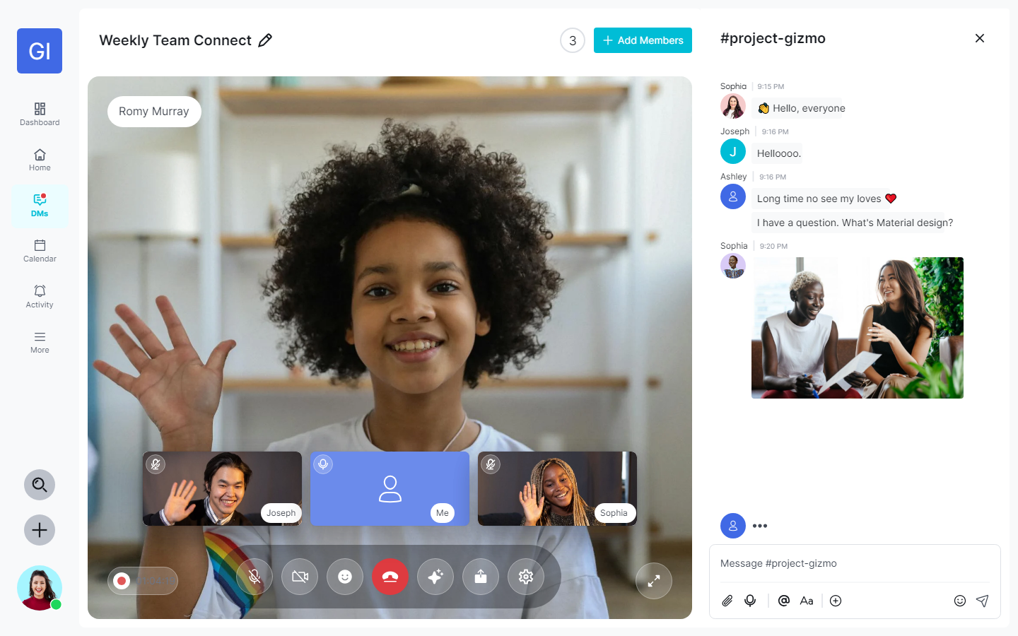
UI Design – Video Call

Slide 16
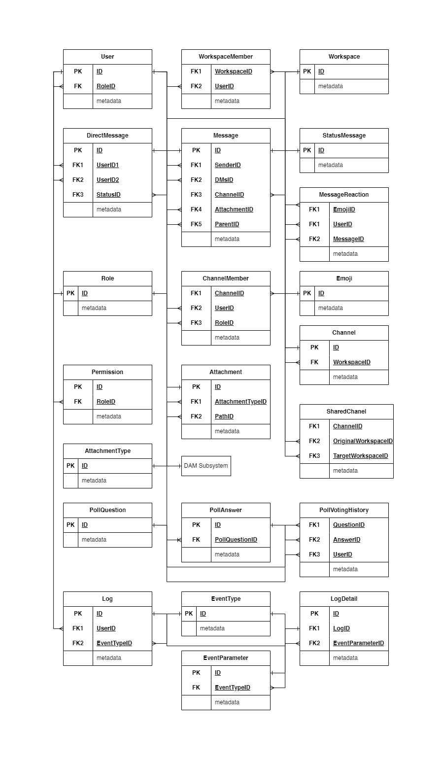
Database Entity – Home

Slide 17

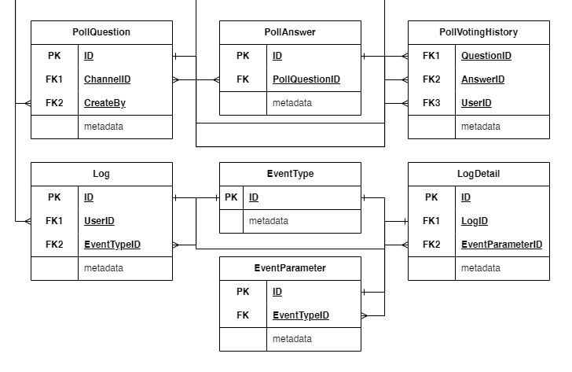
Database Entity – Home

Slide 18
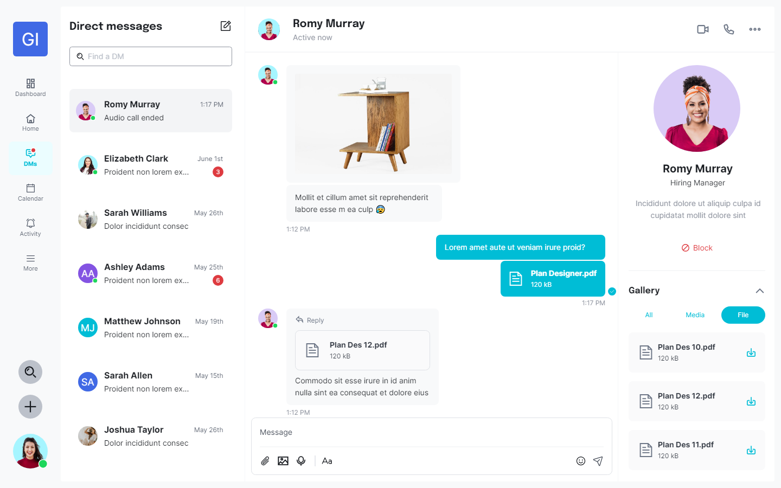
UI Design – Direct Messages

Slide 19
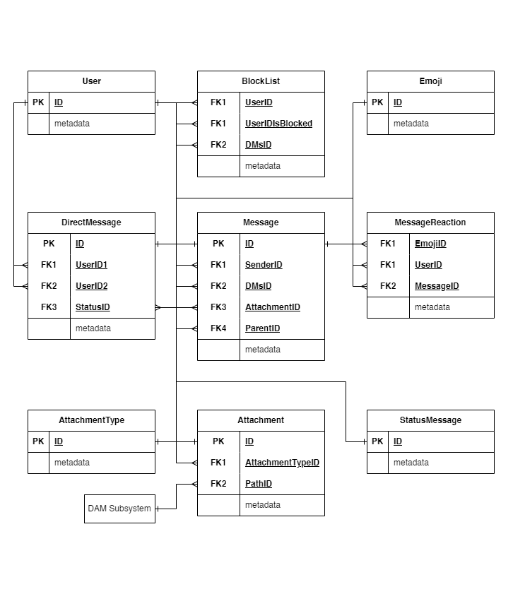
Database Entity – Direct Messages

Slide 20
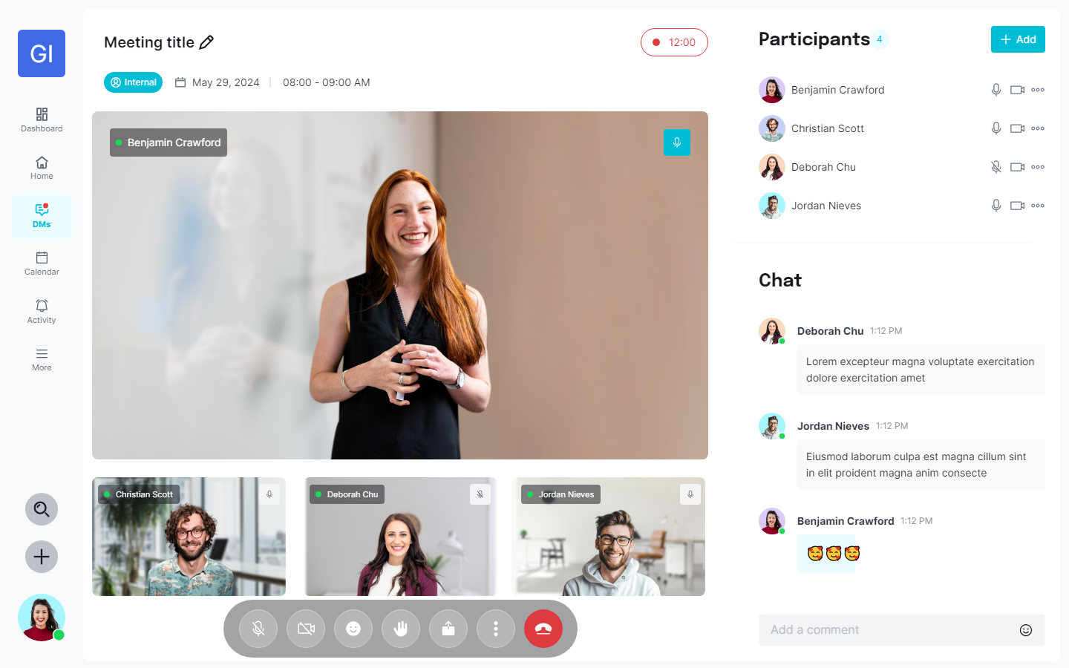
UI Design – Meeting

Slide 21
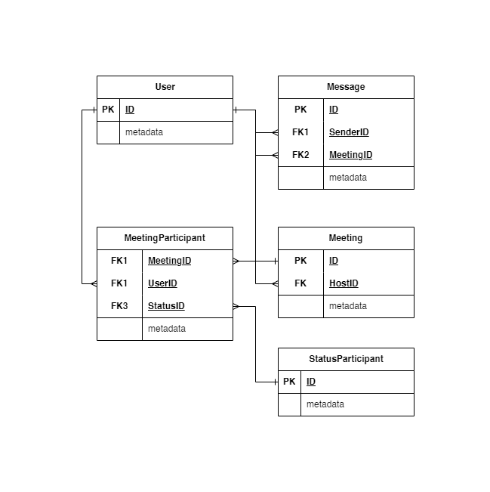
UI Design – Meeting

Slide 22
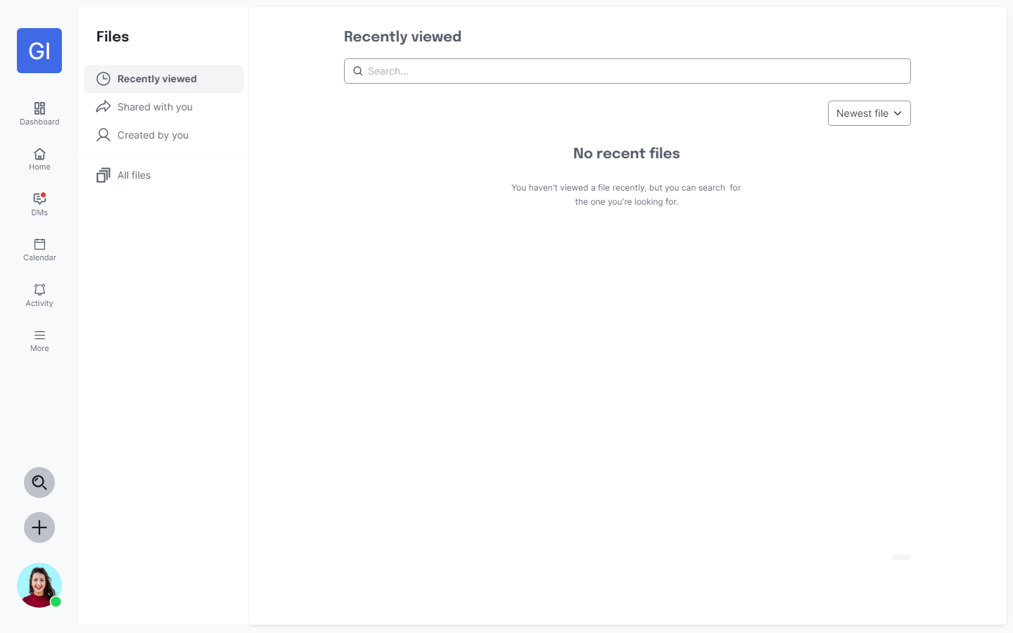
UI Design – Files

Slide 23
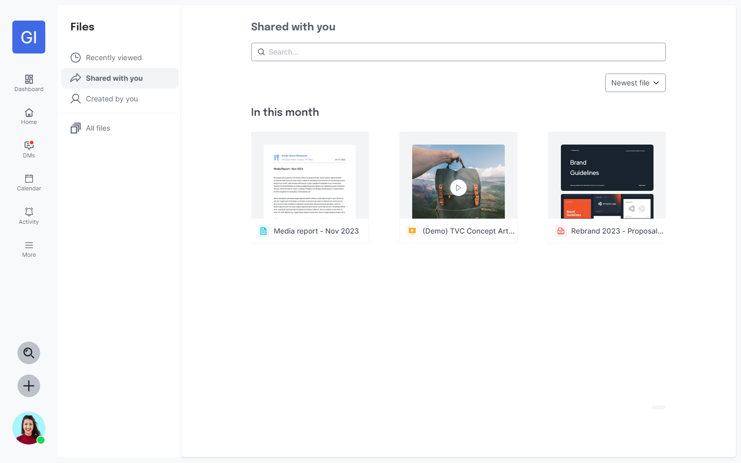
UI Design – Files

Slide 24
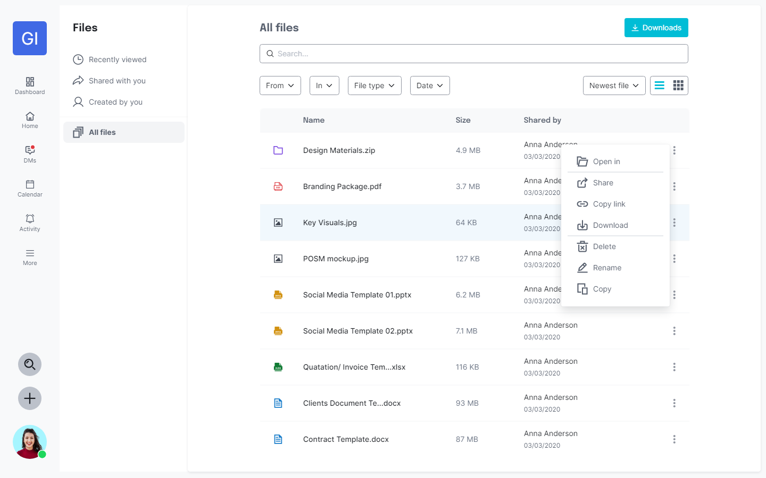
UI Design – Files

Slide 25
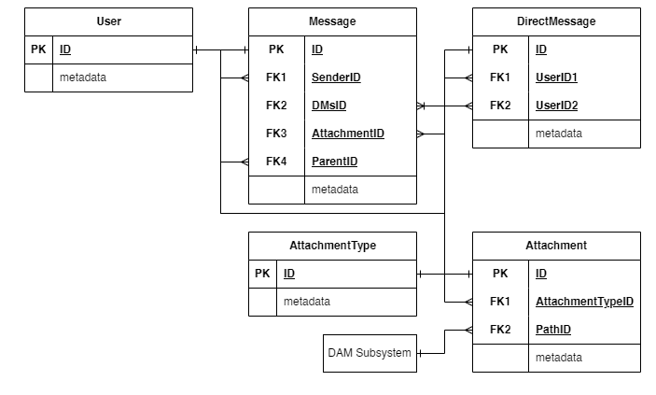
Database Entity – Files

Slide 26
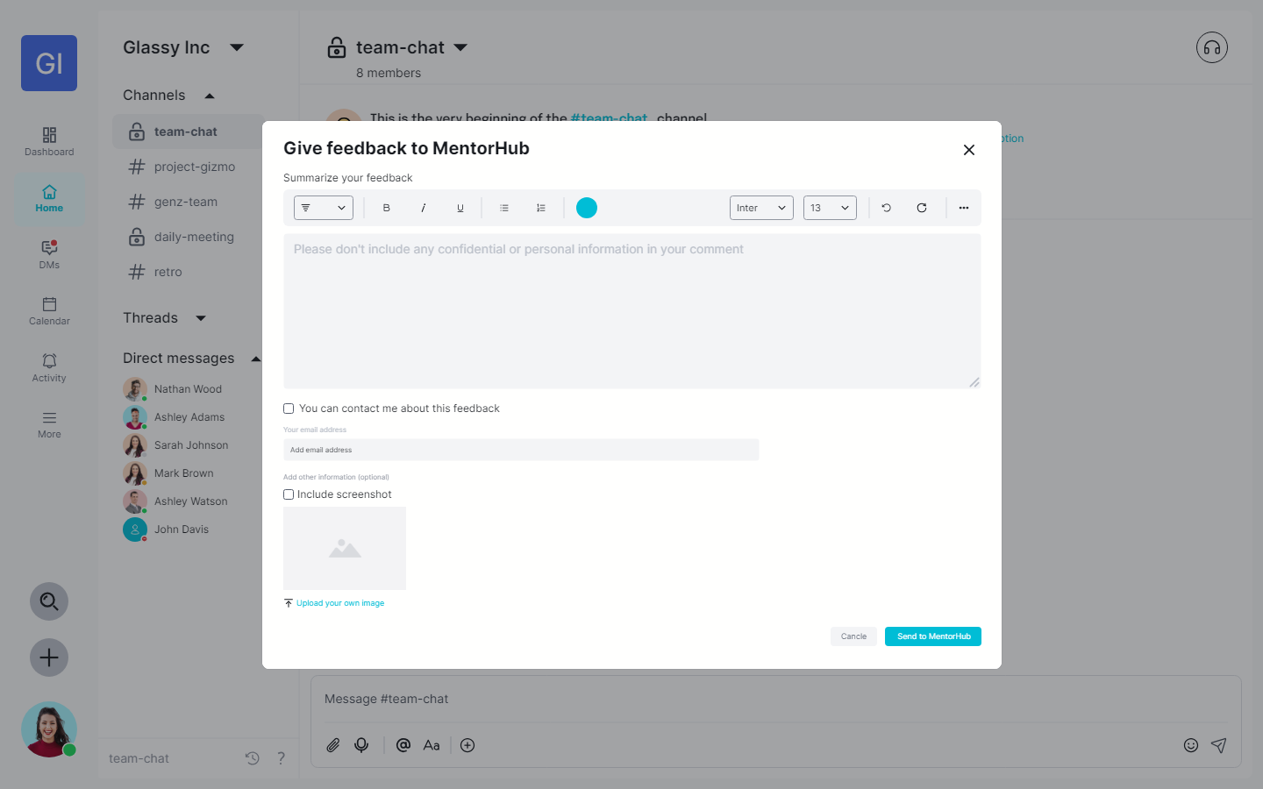
UI Design – Give feedback

Slide 27
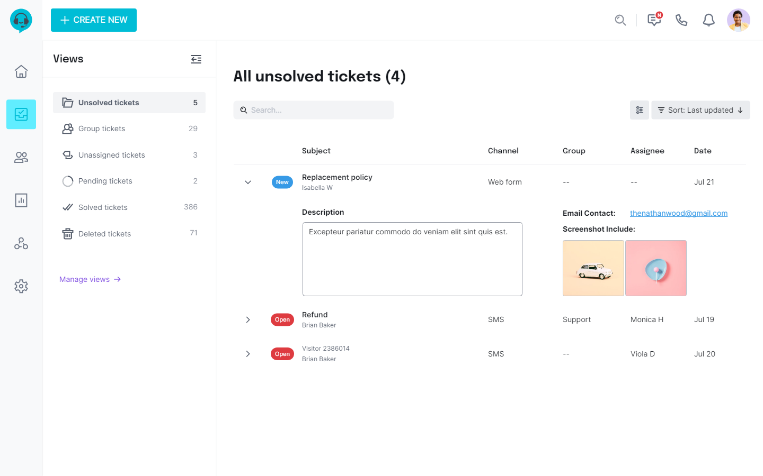
UI Design – Manage Ticket

Slide 28
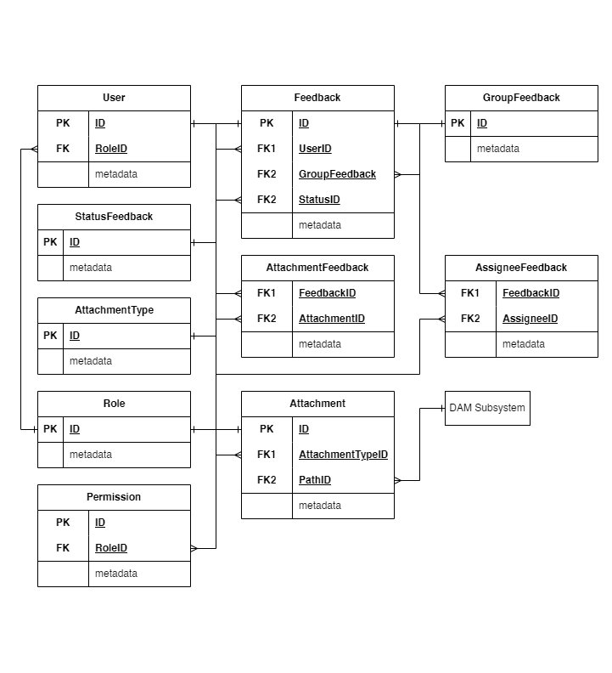
Database Entity – Manage Ticket

Slide 29
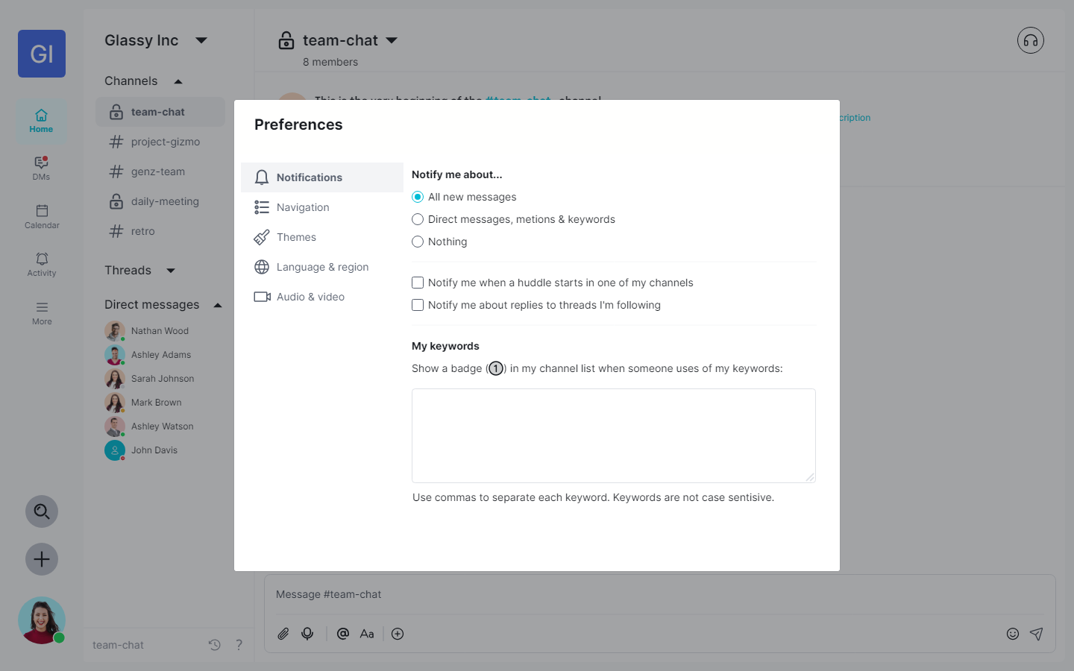
UI Design – Preferences

Slide 30
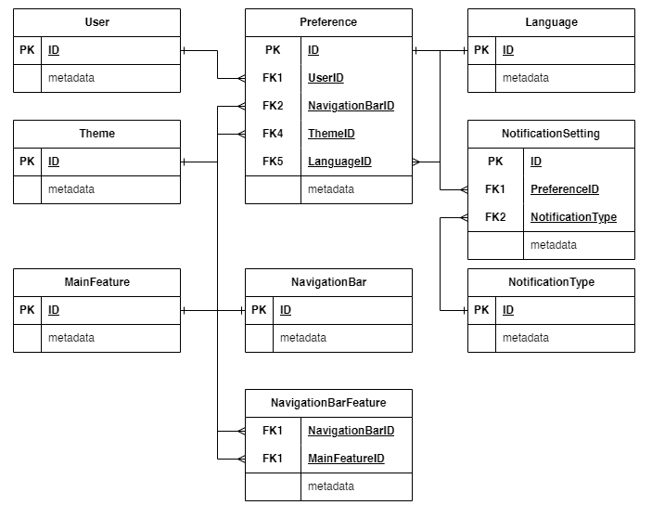
Database Entity – Preferences

Slide 31
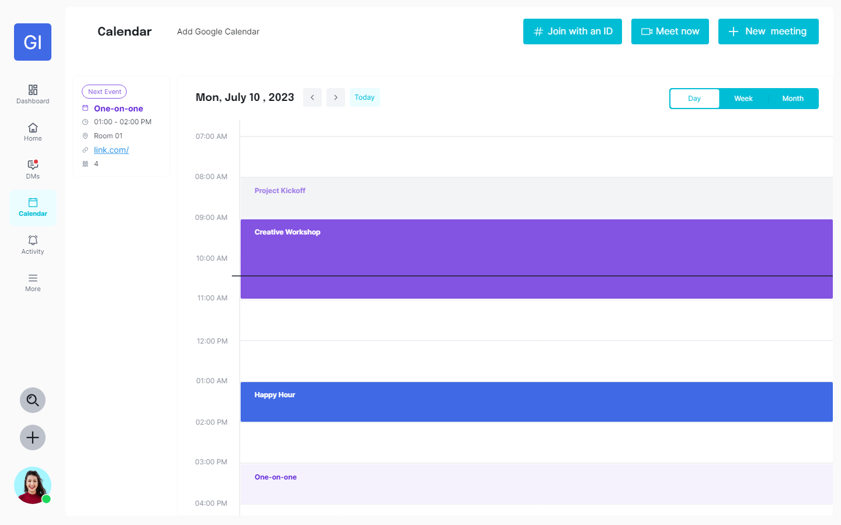
UI Design – Calendar

Slide 32
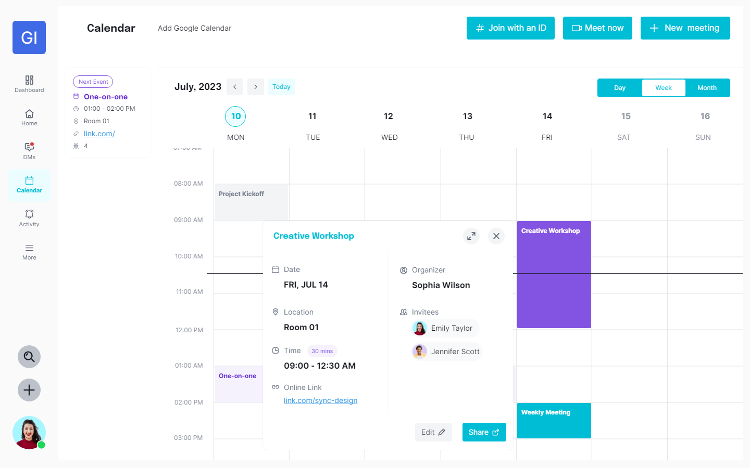
UI Design – Calendar

Slide 33
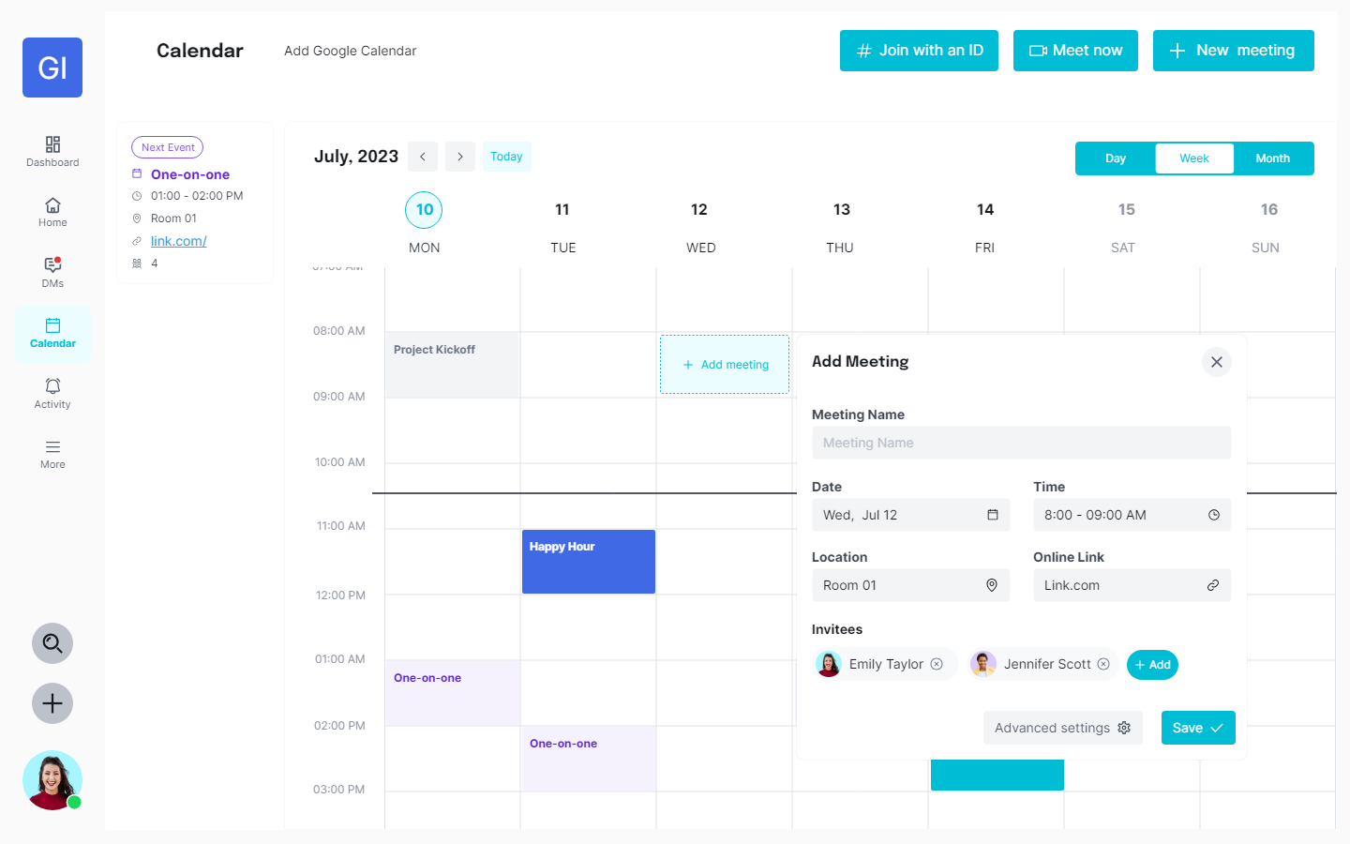
UI Design – Calendar

Slide 34
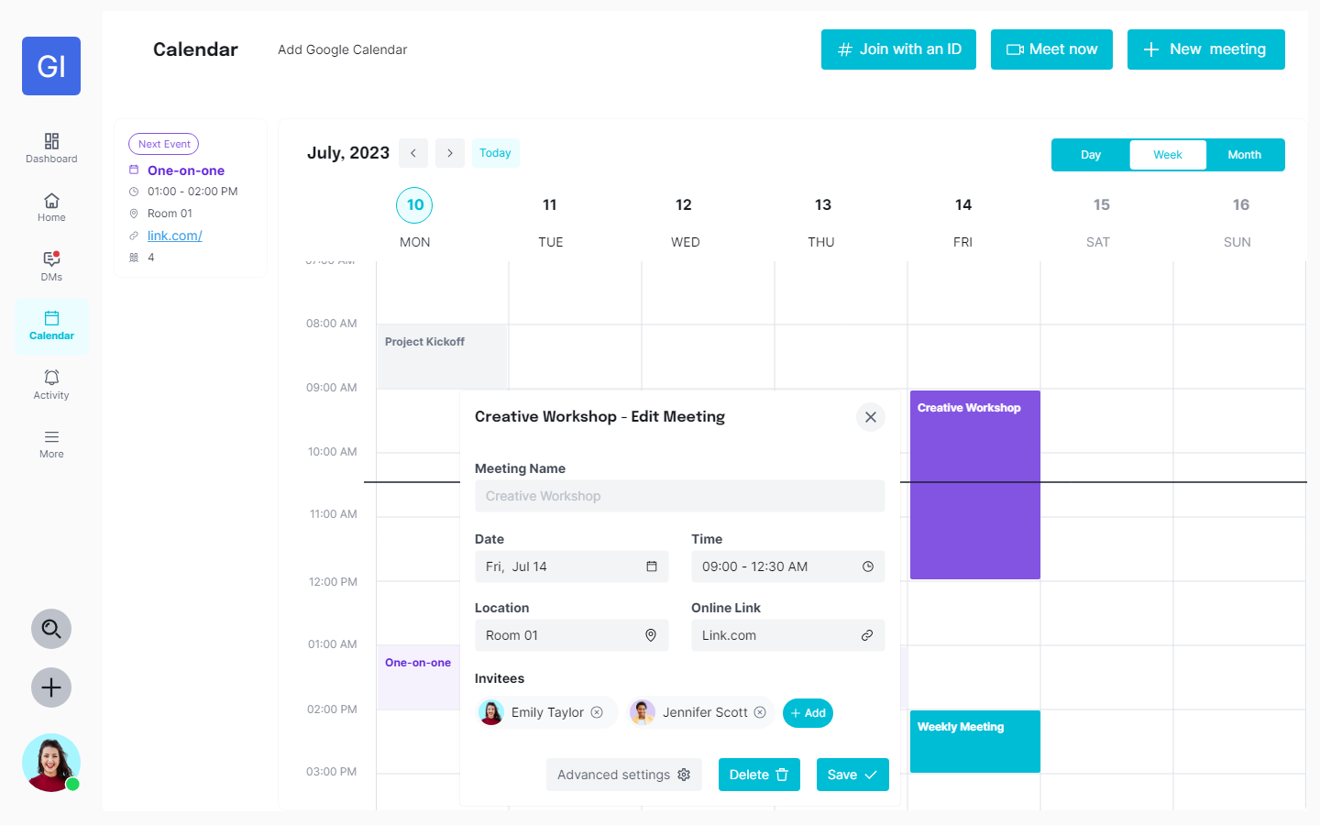
UI Design – Calendar

Slide 35
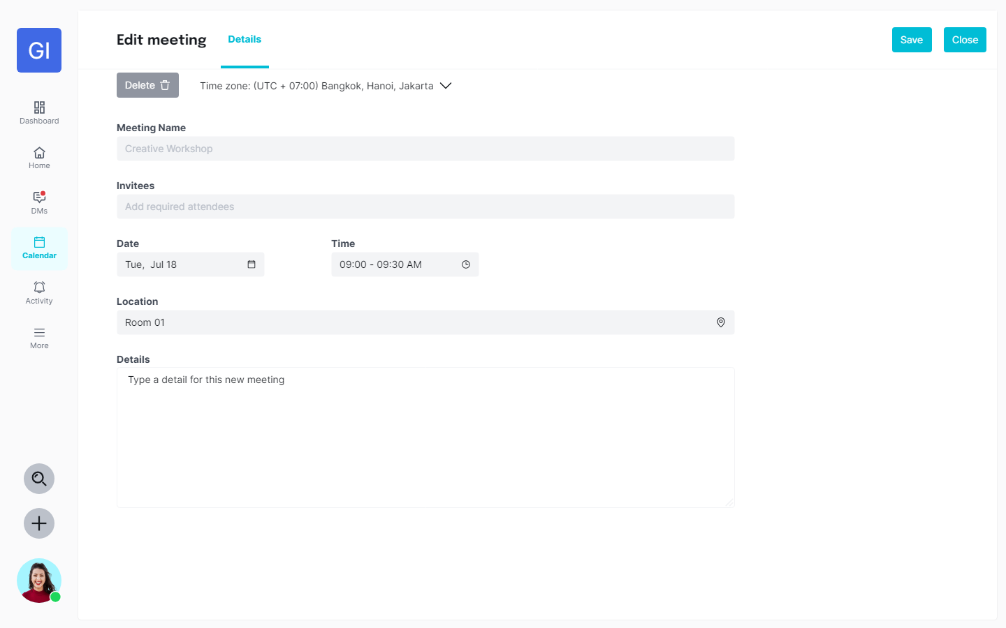
UI Design – Calendar

Slide 36
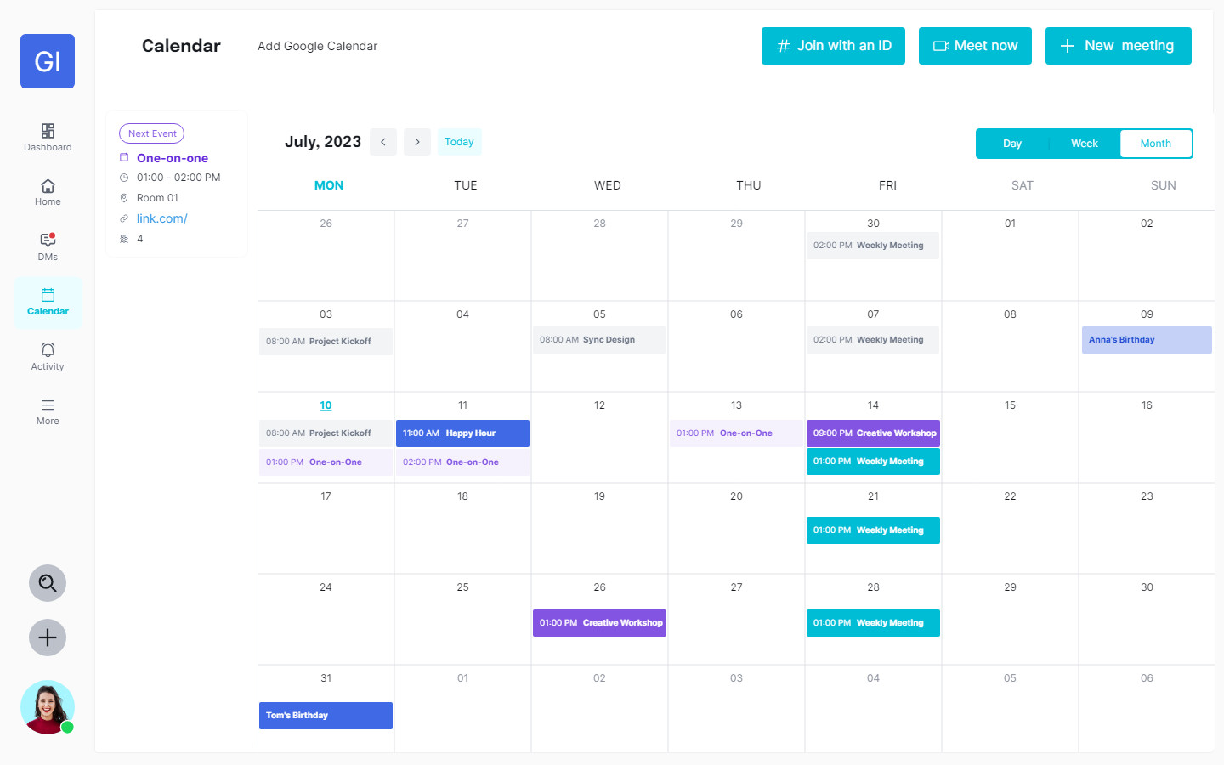
UI Design – Calendar

Slide 37
UI Design – Calendar

Slide 38
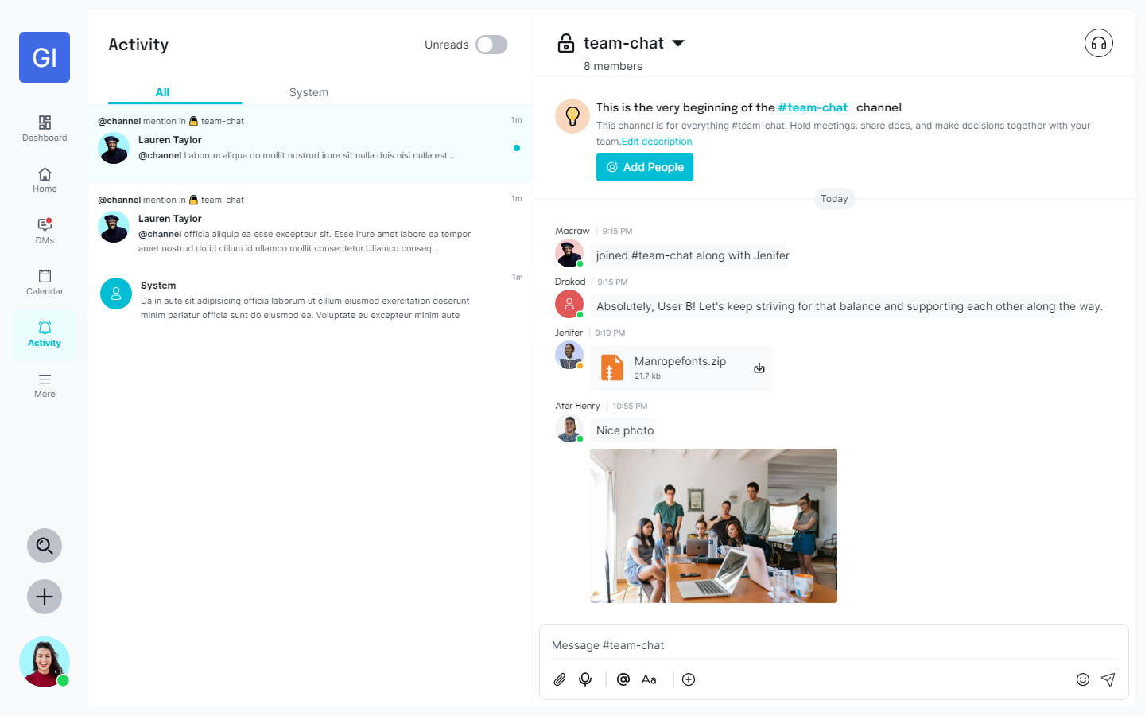
UI Design – Activity

Slide 39
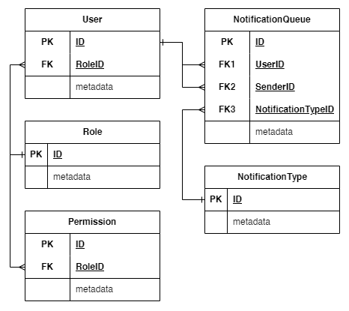
Database Entity – Activity

Slide 40
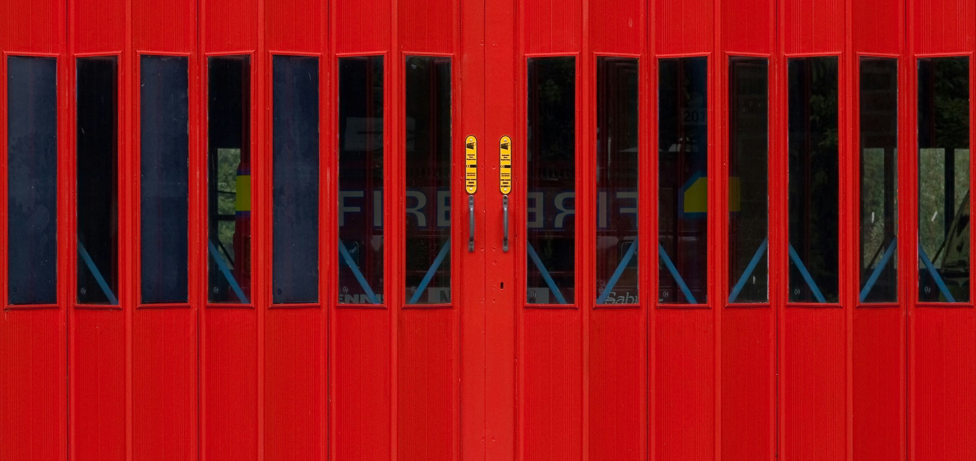
THANK YOU
FOR YOUR TIME

Slide 41

Q&A
QUESTIONS AND ANSWERS

